Slide 1
Non-parametric techniques
Kruskal Wallis Test
Friedman’s ANOVA

Slide 2
Kruskal Wallis Test

Slide 3
Differences between several independent groups: the Kruskal–Wallis test
The Kruskal–Wallis test is the non-parametric counterpart of the one-way independent ANOVA .
The theory is very similar to that of the Mann–Whitney (and Wilcoxon rank-sum) test:
  It is based on ranked data.
  Order the scores from lowest to highest, ignoring the group to which the score belongs, and then assign the lowest score a rank of 1, the next highest a rank of 2 and so on.
  When you’ve ranked the data you collect the scores back into their groups and add up the ranks for each group.

Slide 4
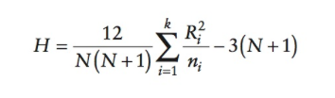
Kruskal–Wallis test statistic, H
  The sum of ranks for each group is denoted by Ri (where i is used to denote the particular group).
The test statistic, H, is calculated as follows:
This test statistic has a distribution from the family of chi-square distributions
In SPSS, look at the row labelled Asymptotic Sig. If the value is less than .05 then the groups are significantly different

Slide 5
Post-Hoc Tests
The Kruskal–Wallis test tells us that, overall, groups come from different populations. However, we don’t know specifically which groups differ.
The simplest thing we can do is to compare all pairs of groups (known as pairwise comparisons).
At a very basic level we could simply perform Mann–Whitney tests making each of these comparisons. However, when we do lots of tests on the same data we inflate the familywise error rate
One way of teasing apart the effects after a Kruskal–Wallis test is to compare every pair of groups, but to adjust the p-value so that overall, across all of the tests, the Type I error rate remains at 5%.

Slide 6
Reporting Results of the Kruskal-Wallis test
Report the H-statistic, the degrees of freedom and the significance value for the main analysis.
For any follow-up tests, report an effect size (you can also report the corresponding z-score and significance value).
Report the medians.

Slide 7
Friedman’s ANOVA

Slide 8
Differences between several related groups: Friedman Test
Used for testing differences between conditions when:
  There are more than two conditions
  The same participants have been used in all conditions (each case contributes several scores to the data).
If you have violated some assumption of parametric tests then this test can be a useful alternative.

Slide 9
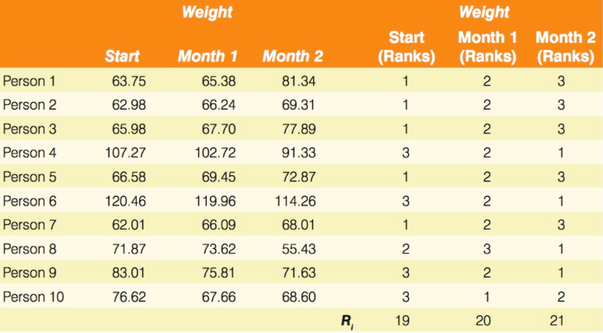
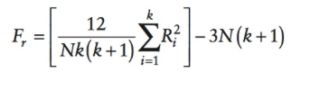
Friedman Test – General Approach
Place the data for different conditions into different columns. Add up the ranks for each condition (R_{i}, where i is used to denote the particular group)
Test Statistic:

Slide 10
Example: Friedman Test
Source: J Pallant, SPSS Survival Manual
Research Question:
Is there a change in Fear of Statistics Test scores across three time periods?
See experim5ED.sav

Slide 11
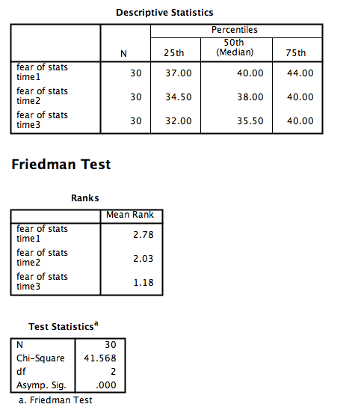
Friedman Test – SPSS Output

